Slide 1
DATABASE Management system project
Team members:
Akash Chauhan- 20CS3006
Animay Prakash- 20CS3073
Under prof. niraj kumar

Slide 2
Topic- COVID BED SLOT BOOKING
The objective of our website is to provide an efficient bed management system for covid patients in hospitals.

Slide 3
acknowledgement
Having real world experience by doing Project is an great opportunity. We would like to express our special thanks of gratitude to our Professor DR. Niraj Kumar as well as our Director DR. ASK Sinha who gave us the golden opportunity to do this wonderful project on Database Management Systems, which also helped us in doing a lot of Research and we came to know about so many new things. We are really thankful to them.

Slide 4
Description
Bed Management in this pandemic has become an issue that almost all of the families of covid patients face. But by using the latest technology this problem can be solved, The main reason for this problem is hospitals not having a proper portal for managing beds. Our solution to this problem can be used to save many lives of covid patients. Therefore we have tried to address this problem with help of our project where the focus is to make sure that every covid patient gets a bed. We have achieved this by creating one website for users through which they can request a bed in a hospital and also where hospitals can manage beds.

Slide 5
Tech stack
HTML, CSS, JAVASCRIPT
PYTHON
FLASK
MYSQL
SQL ALCHEMY
XAMPP Server

Slide 6
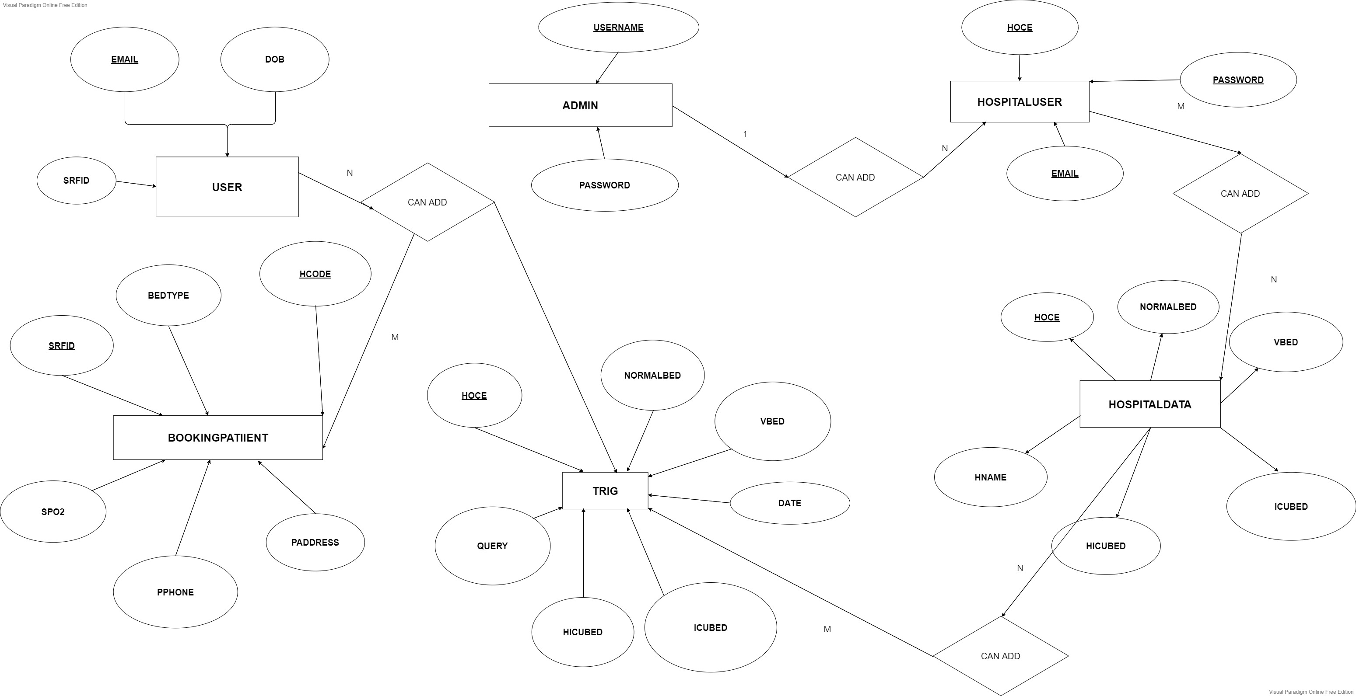
Er diagram

Slide 7
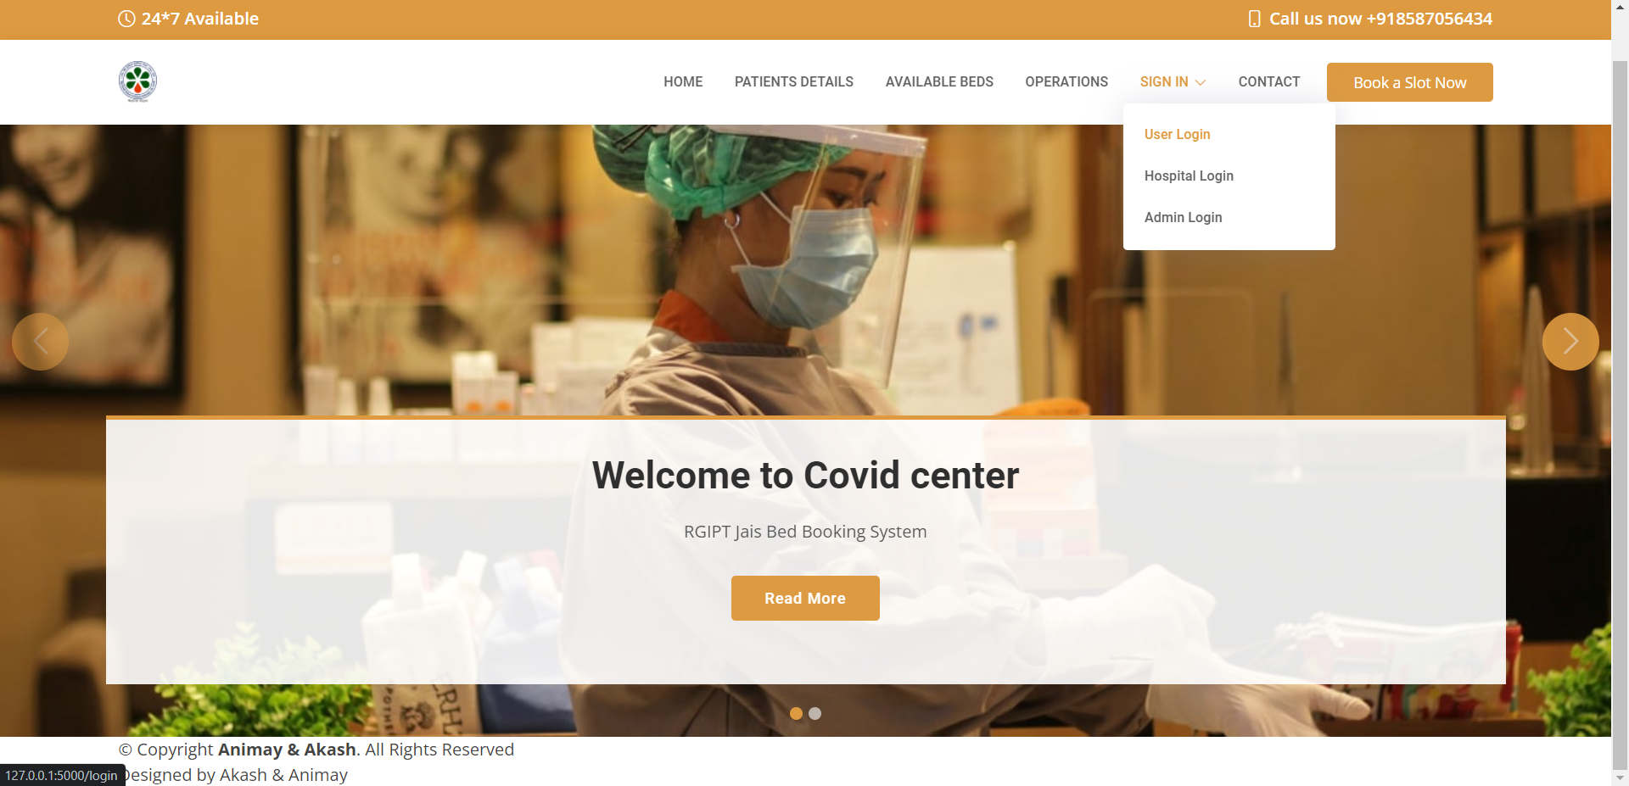
Home Page

Slide 8
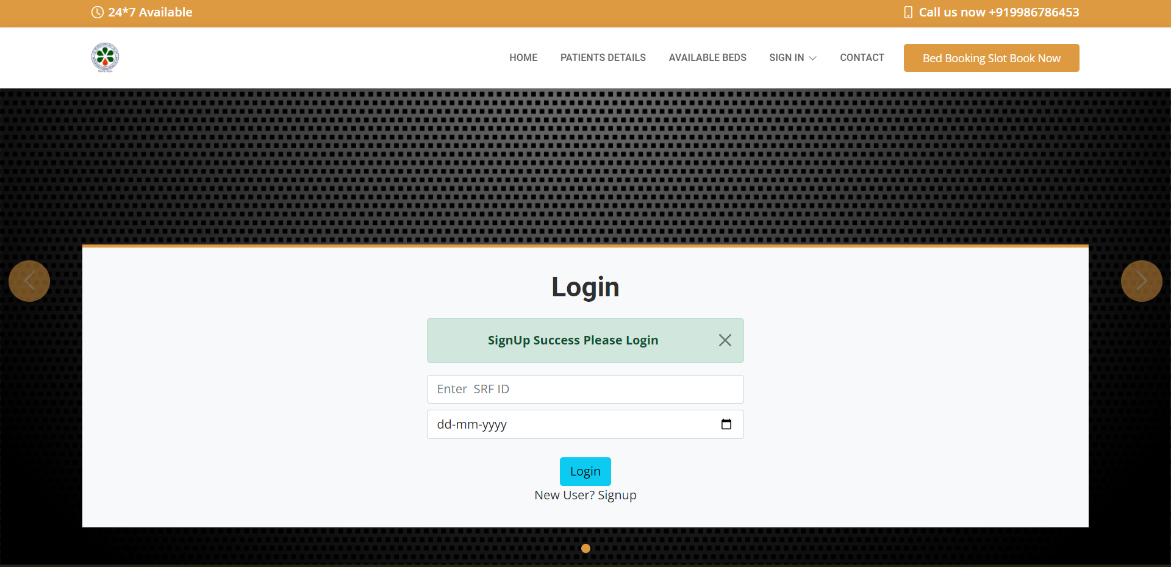
Login- user/patient

Slide 9
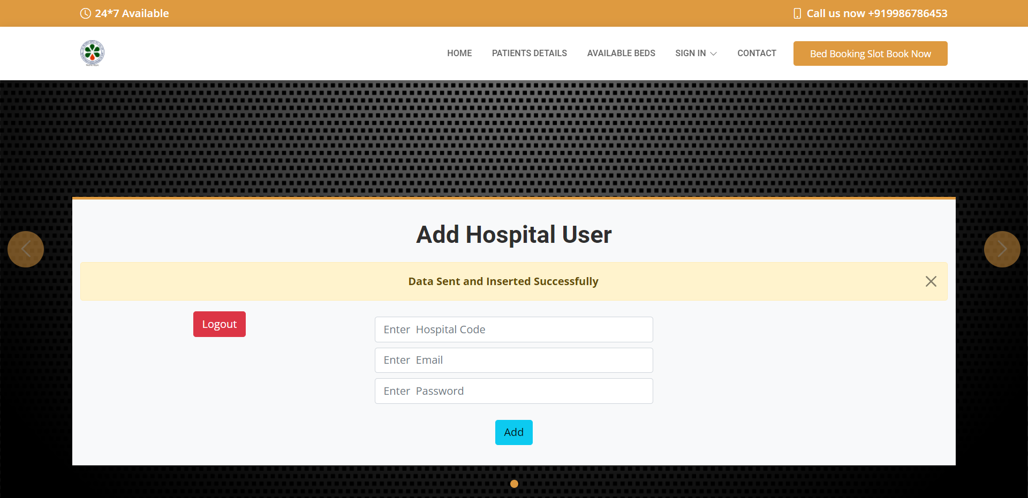
Hospital login

Slide 10
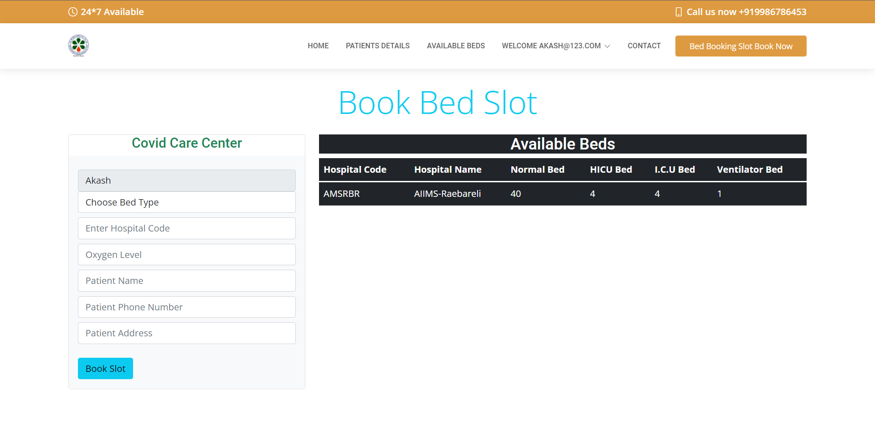
Available bed slots

Slide 11
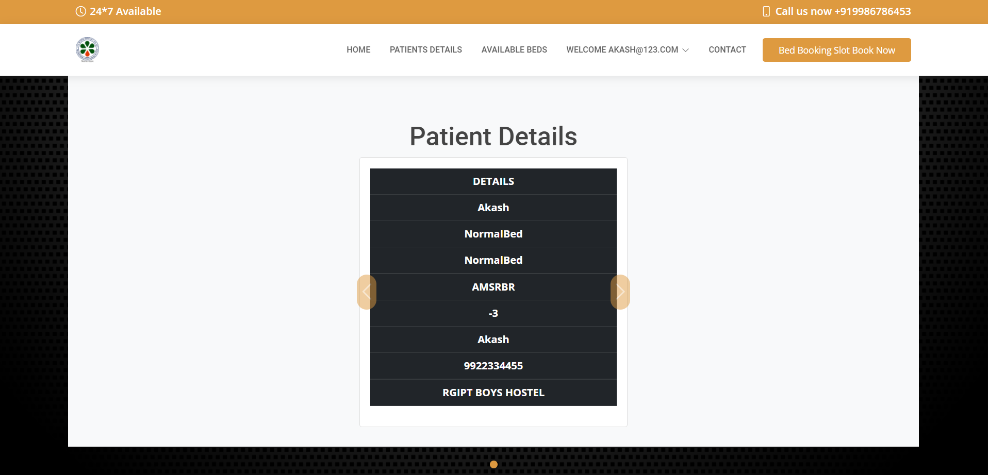
Booking details

Slide 12
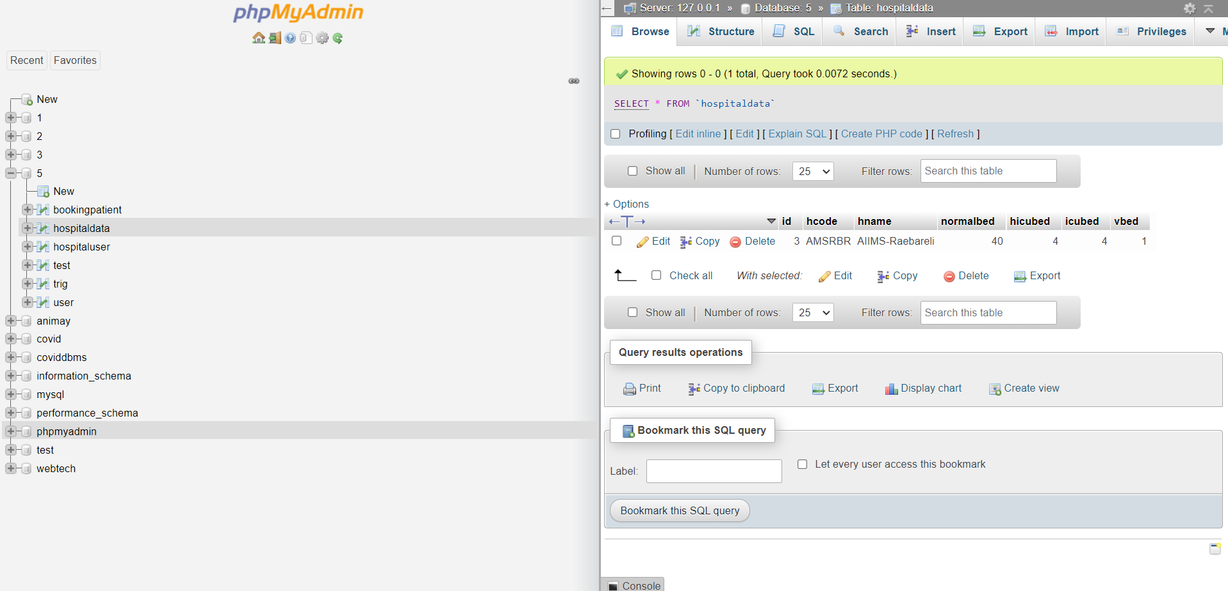
database

Slide 13
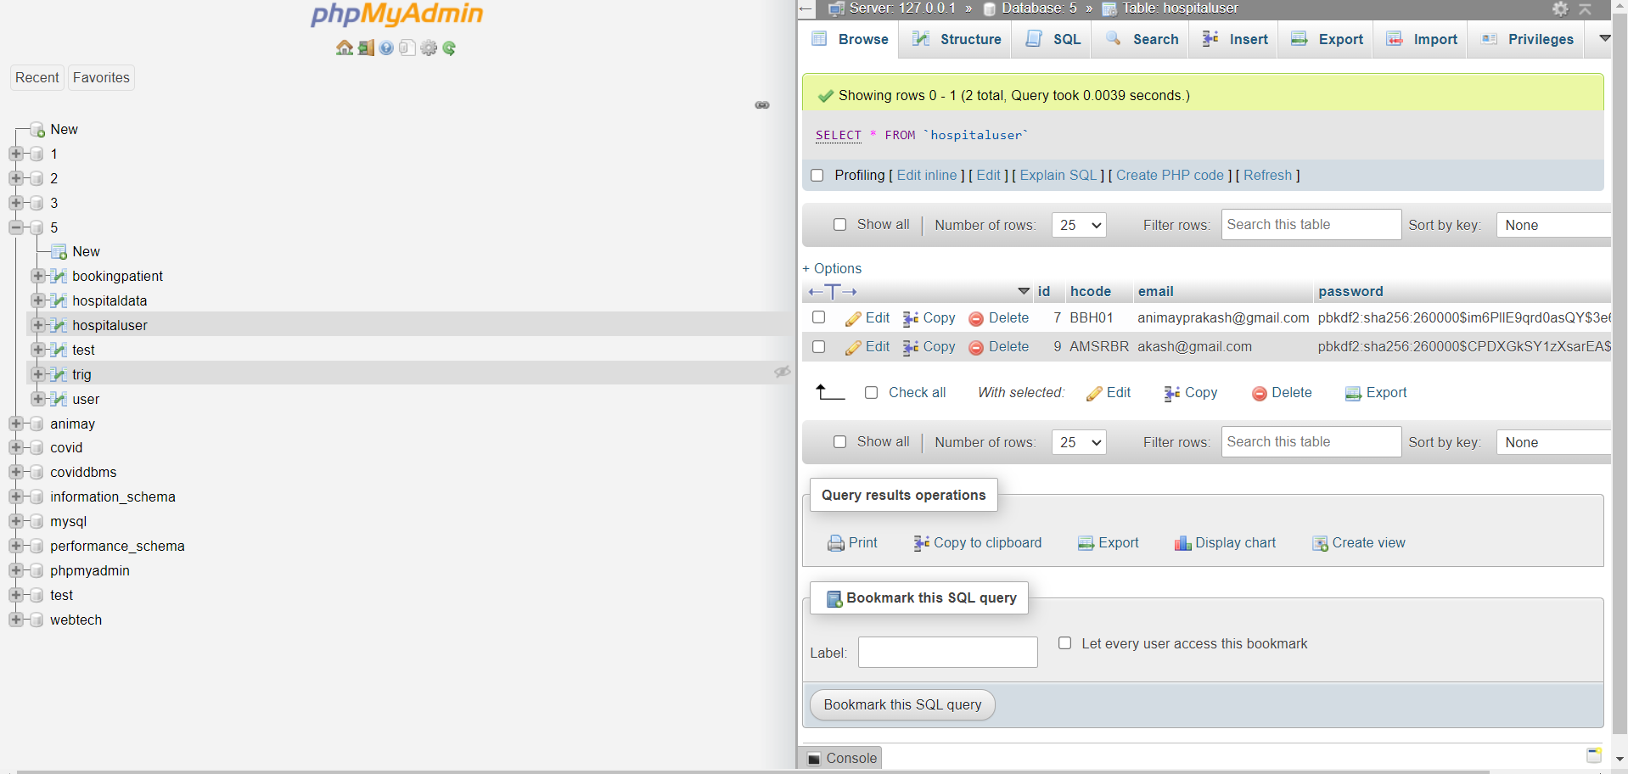
database

Slide 14
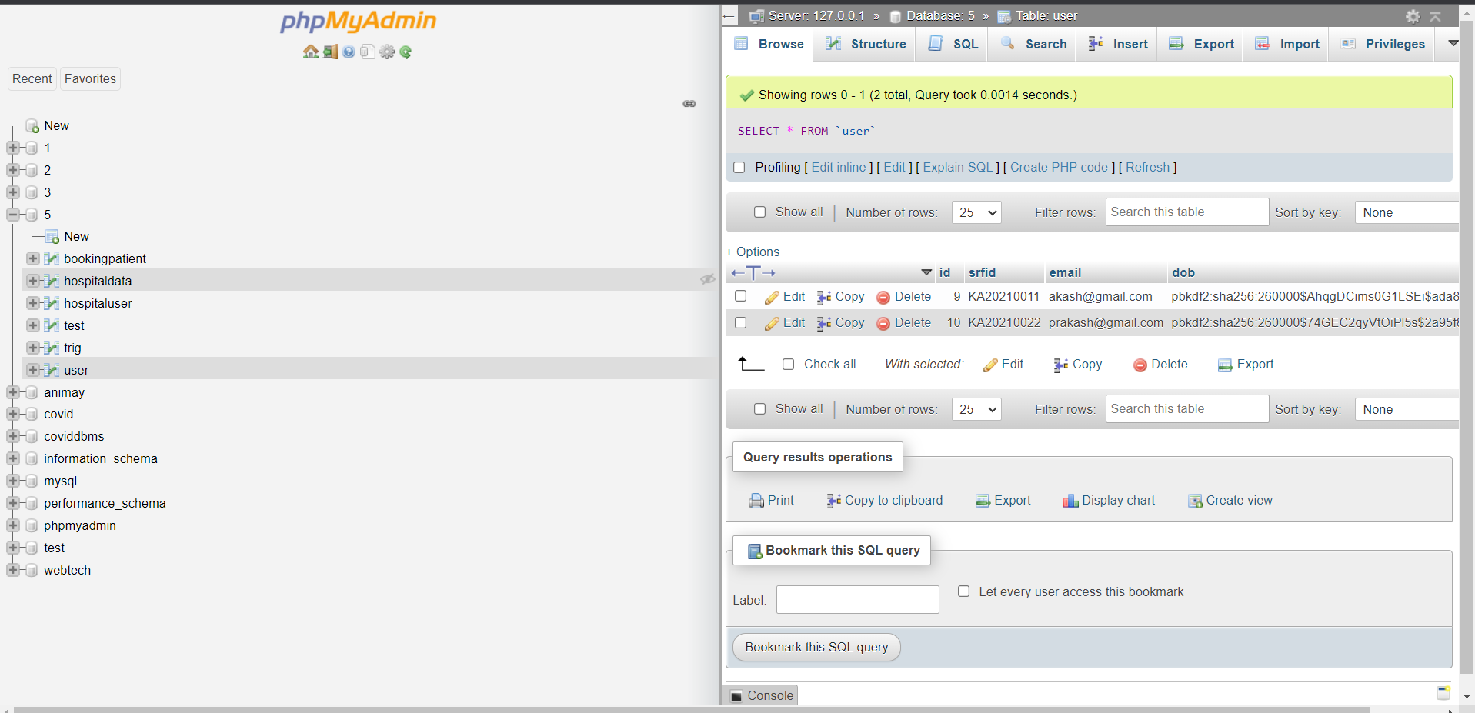
database

Slide 15
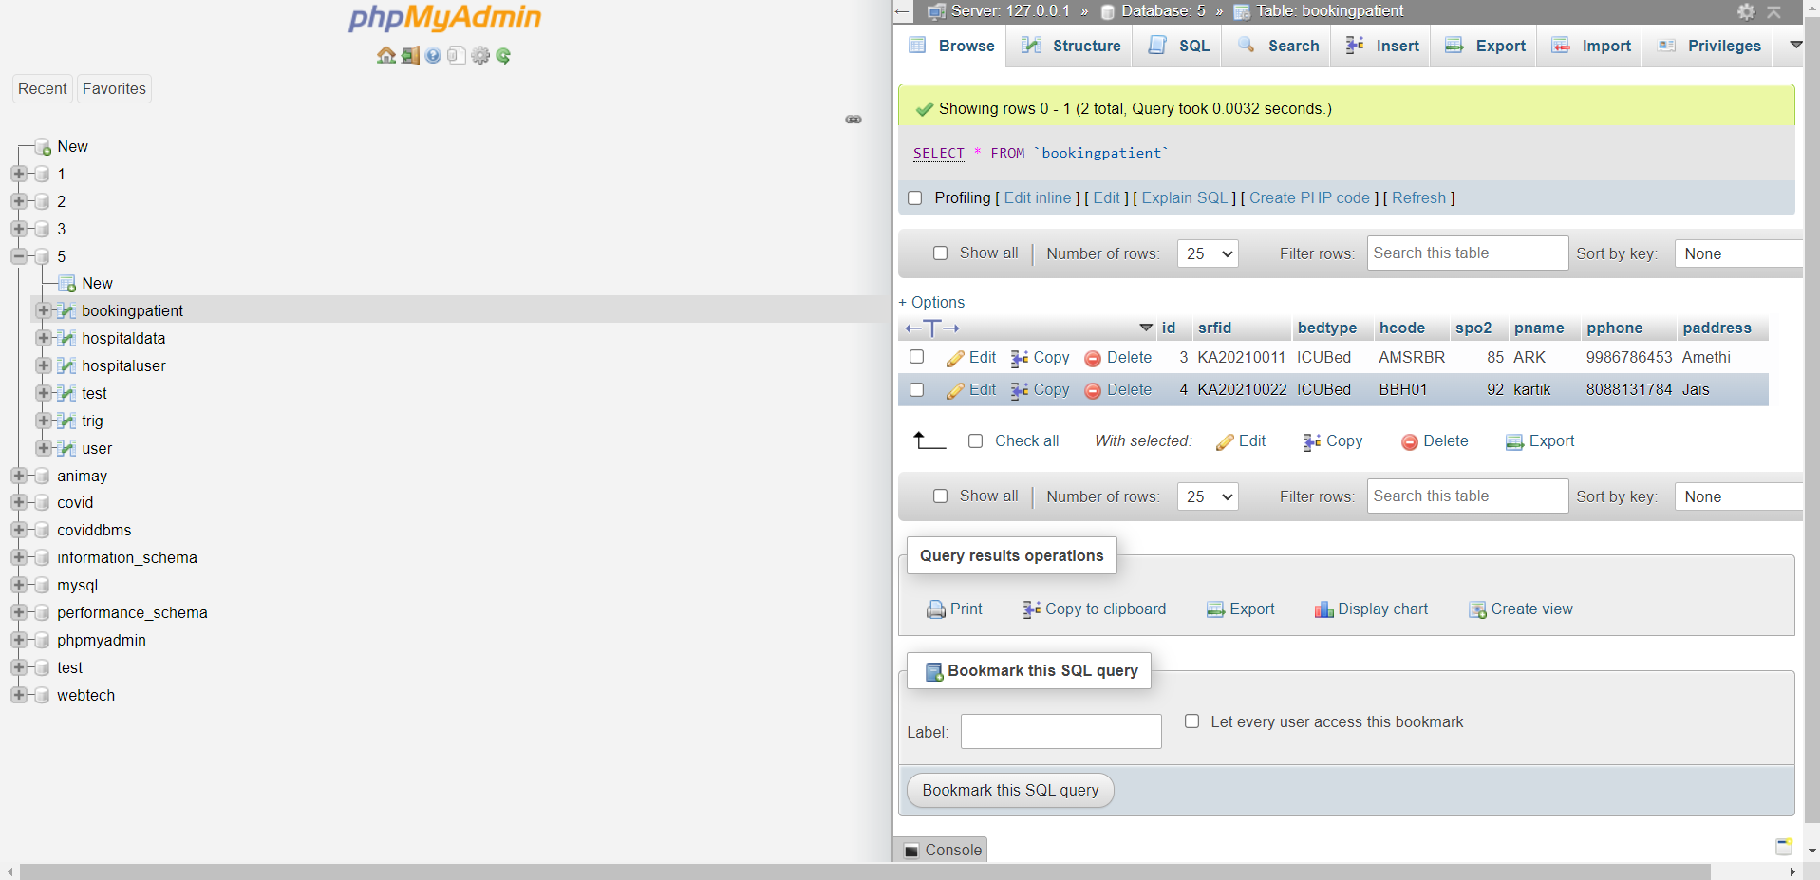
database

Slide 16
THANK YOU

